Slide 1

State Innovation Model (SIM)
Sustaining Healthcare Transformation
Craig Jones
Director, Vermont Blueprint for Health
December 8, 2015

Slide 2

Vermont’s Community Oriented PCMH Model
Hospitals
Specialty Care & Disease Management Programs
Advanced Primary Care
Community Health Team
Nurse Coordinator
Social Workers
Nutrition Specialists
Community Health Workers
Public Health Specialist
Extended Community Health Team
Medicaid Care Coordinators
SASH Teams
Spoke (MAT) Staff
Social & Economic Services
Advanced Primary Care
Home & Long Term Support Services
Advanced Primary Care
Mental Health & Substance Abuse Specialty Programs
Advanced Primary Care
Self Management Programs
Public Health Programs & Services
All-Insurer Payment Reforms
Local leadership, Practice Facilitators, Workgroups
Local, Regional, Statewide Learning Forums
Health IT Infrastructure
Evaluation & Comparative Reporting

Slide 3
Timeline for Implementation

Slide 4
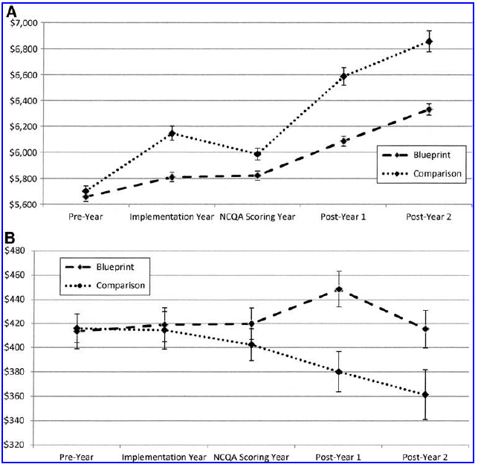
Impact on Expenditures and Services
Expenditures Per Person
Expenditures on healthcare for the whole population
Medicaid expenditures
on special services
Population Health Management 2015

Slide 5
Progress Towards Population Health
Integration With ACOs & Community Organization
  Integration of ACO and Blueprint workgroups & support network
  Leadership team including medical & community providers
  Focus on improving coordination, quality, core ACO measures
  Guide community health teams & transformation network
  New medical home payment model
  Progress in all 14 service areas

Slide 6
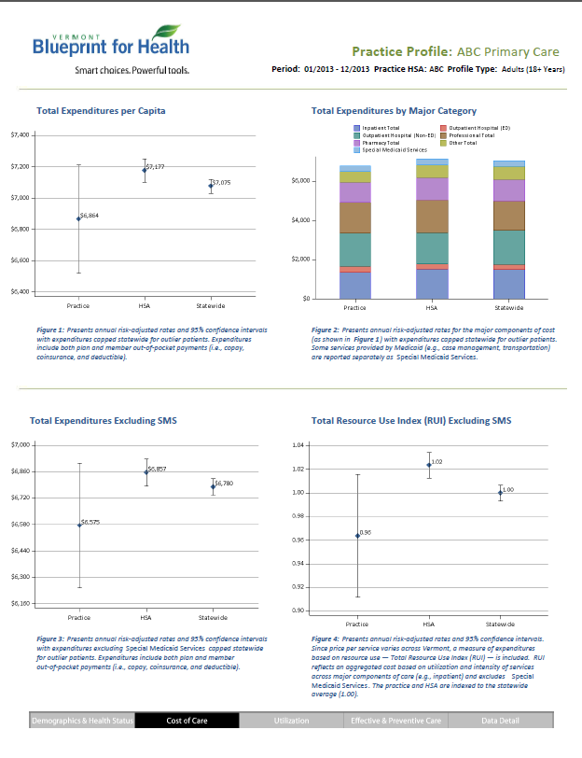
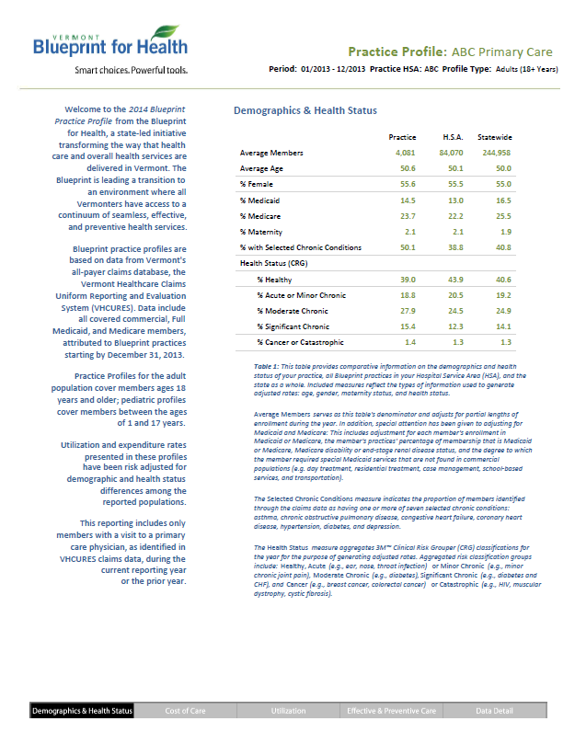
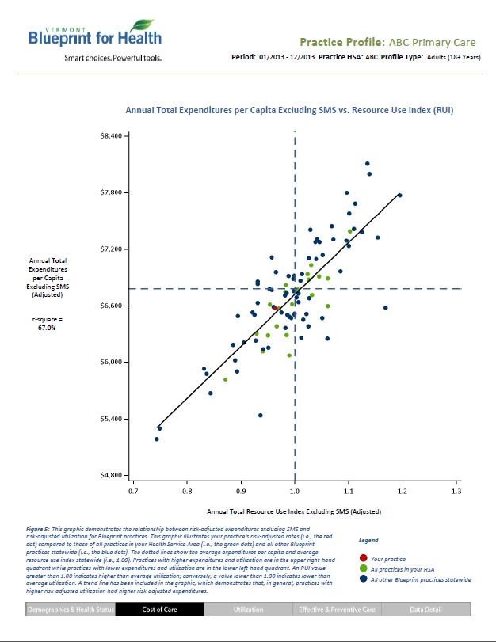
Progress Towards Population Health
Whole Population Comparative Evaluation
Practice and Service Area Profiles

Slide 7
Transition to a Sustainable Health System
SIM
Federal Accelerators
Aligned Medicare & Medicaid Waivers, Next Generation ACO.
All Payer Accountable Health System
MAT Health Home
Shift to GC
Multi Payer Advanced Primary Care Demonstration
Medicaid Global Commitment Waiver
ARRA (Stimulus), HITECH Act
2008
2009
2010
2011
2012
2013
2014
2015
2016
2017
2018
2019
PCMH & CHT pilots. Multi-insurer payment reforms. Develop transformation network, data infrastructure, and analytic capacity.
SIM stakeholder groups. ACOs form and develop statewide networks. Shared savings programs. Core measure selection. Collaboratives. Data and health information system enhancements.
Community oriented accountable health system & universal primary care?
Statewide hub & spoke program
Statewide PCMHs, CHTs, SASH, self management programs. All-insurer payment reforms. Comparative evaluation, dashboards, learning activities.
Community collaborative structure. Population health focus & new PCMH payment model.
Expansion of EHR use, HIE development, Meaningful Use

Slide 8
Building on SIM
Ingredients to Maintain Progress
Common mission, shared interests, and strong leadership are essential
Core measures help define priorities and establish shared interests
Multi-payer payment reforms linked to shared interests & core measures
Payment reforms stimulate more complete medical & non-medical services
Consistent measurement, comparative reporting, transparency
States can offer unique leadership, regulatory, and convening opportunities

